Slide 1
Housing project

Slide 2
Introduction
Problem statement:-
Houses are one of the necessary need of each and every person around the globe and therefore housing and real estate market is one of the markets which is one of the major contributors in the world’s economy. It is a very large market and there are various companies working in the domain. Data science comes as a very important tool to solve problems in the domain to help the companies increase their overall revenue, profits, improving their marketing strategies and focusing on changing trends in house sales and purchases. Predictive modelling, Market mix modelling, recommendation systems are some of the machine learning techniques used for achieving the business goals for housing companies. Our problem is related to one such housing company.
A US-based housing company named Surprise Housing has decided to enter the Australian market. The company uses data analytics to purchase houses at a price below their actual values and flip them at a higher price. For the same purpose, the company has collected a data set from the sale of houses in Australia.
The company is looking at prospective properties to buy houses to enter the market. You are required to build a model using Machine Learning in order to predict the actual value of the prospective properties and decide whether to invest in them or not

Slide 3
Exploratory Data Analysis
1. Checking the Missing Values
2.categorical data visualisation
3.numerical data and label relationship
4.checking outlier
5.checking skewness and distribution of numerical data

Slide 4
Checking null values
null_counts = df.isnull().sum()
null_counts[null_counts > 0].sort_values(ascending=False)
PoolQC 1161
MiscFeature 1124
Alley 1091
Fence 931
FireplaceQu 551
LotFrontage 214
GarageType 64
GarageYrBlt 64
GarageFinish 64
GarageQual 64
GarageCond 64
BsmtExposure 31
BsmtFinType2 31
BsmtCond 30
BsmtFinType1 30
BsmtQual 30
MasVnrArea 7
MasVnrType 7
dtype: int64

Slide 5
Filling missing value
df["LotFrontage"].fillna(df['LotFrontage'].mean(),inplace=True)
df["MasVnrArea"].fillna(df['MasVnrArea'].mean(),inplace=True)
df["GarageYrBlt"].fillna(df['GarageYrBlt'].mean(),inplace=True)
df["Fence"].fillna("MnPrv",inplace=True)
df["FireplaceQu"].fillna("Gd",inplace=True)
df["GarageType"].fillna("Attchd",inplace=True)
df["GarageFinish"].fillna("Unf",inplace=True)
df["GarageQual"].fillna("TA",inplace=True)
df["GarageCond"].fillna("GarageCond",inplace=True)
df["BsmtExposure"].fillna("No",inplace=True)
df["BsmtFinType2"].fillna("Unf",inplace=True)
df["BsmtCond"].fillna("TA",inplace=True)
df["BsmtFinType1"].fillna("Unf",inplace=True)
df["BsmtQual"].fillna("TA",inplace=True)
df["MasVnrType"].fillna("None",inplace=True)

Slide 6
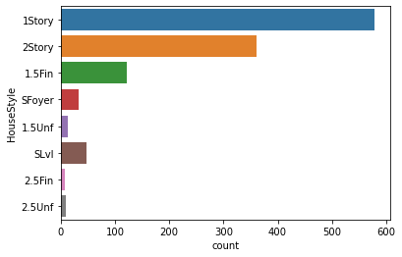
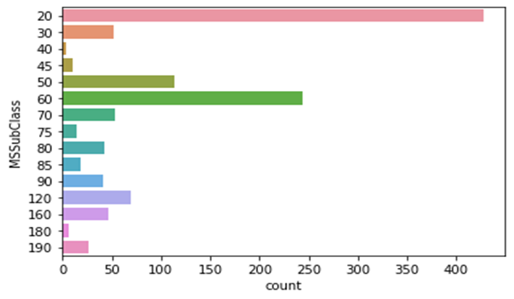
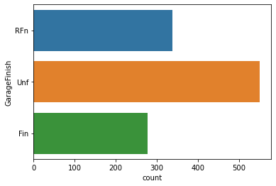
Data visualisation

Slide 7
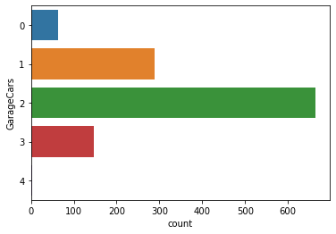
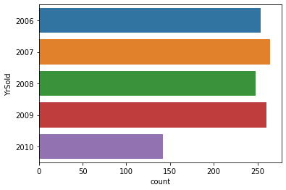
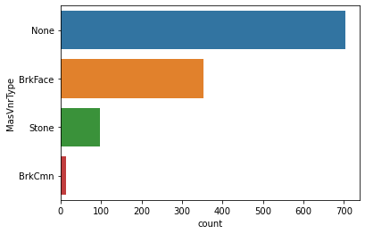

Slide 8
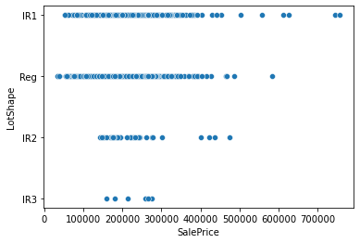
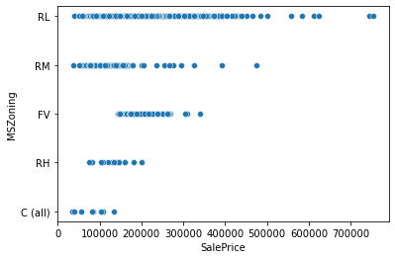
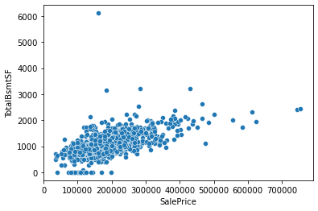
Relation between features and label

Slide 9
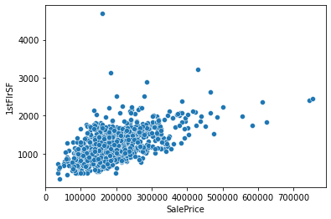
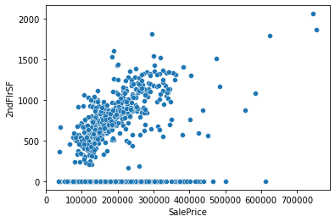
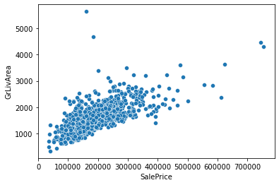

Slide 10
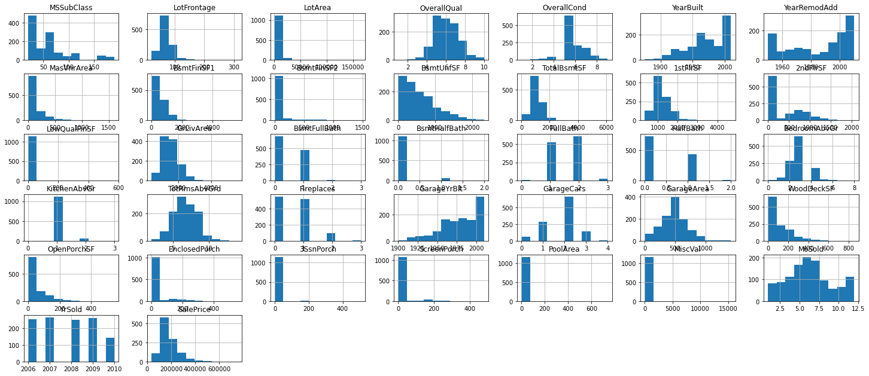
<AxesSubplot:>, <AxesSubplot:>, <AxesSubplot:>]], dtype=object)
In [16]:
#finding correlation

Slide 11
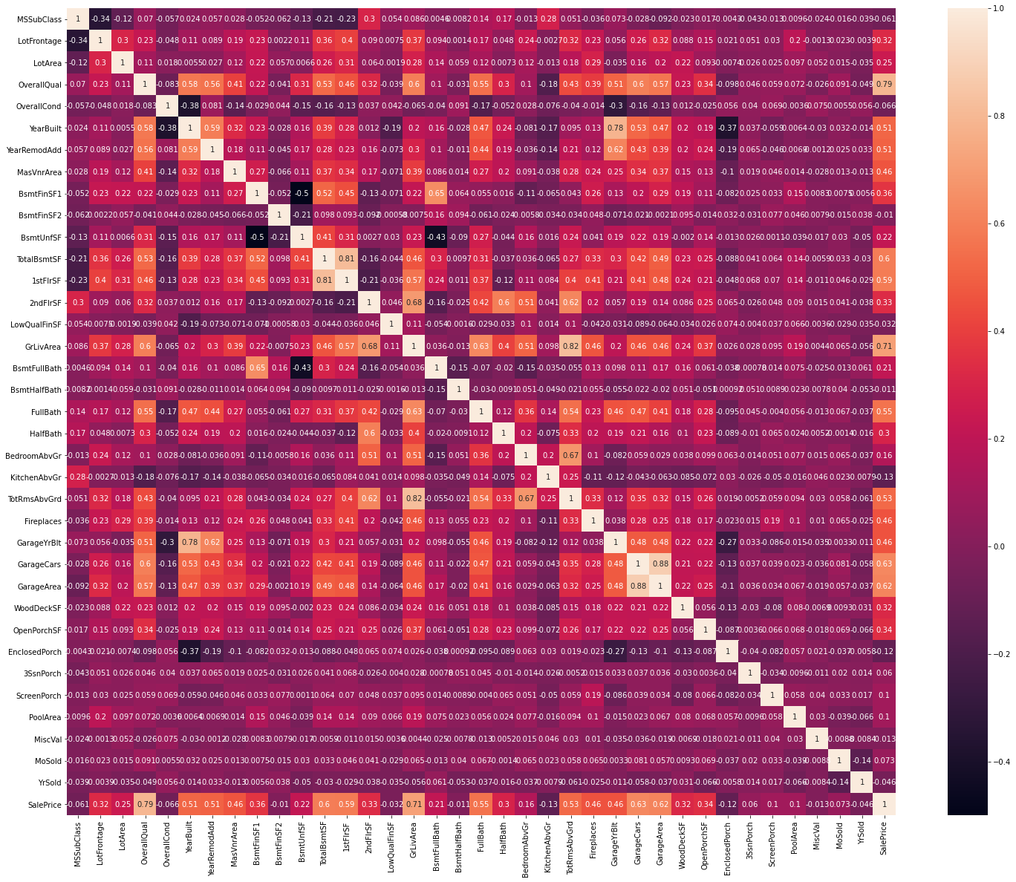

Slide 12
Converting into numerical data
from sklearn.preprocessing import OrdinalEncoder
enc=OrdinalEncoder()
for i in df.columns:
if df[i].dtypes=="object":
df[i]=enc.fit_transform(df[i].values.reshape(-1,1))

Slide 13
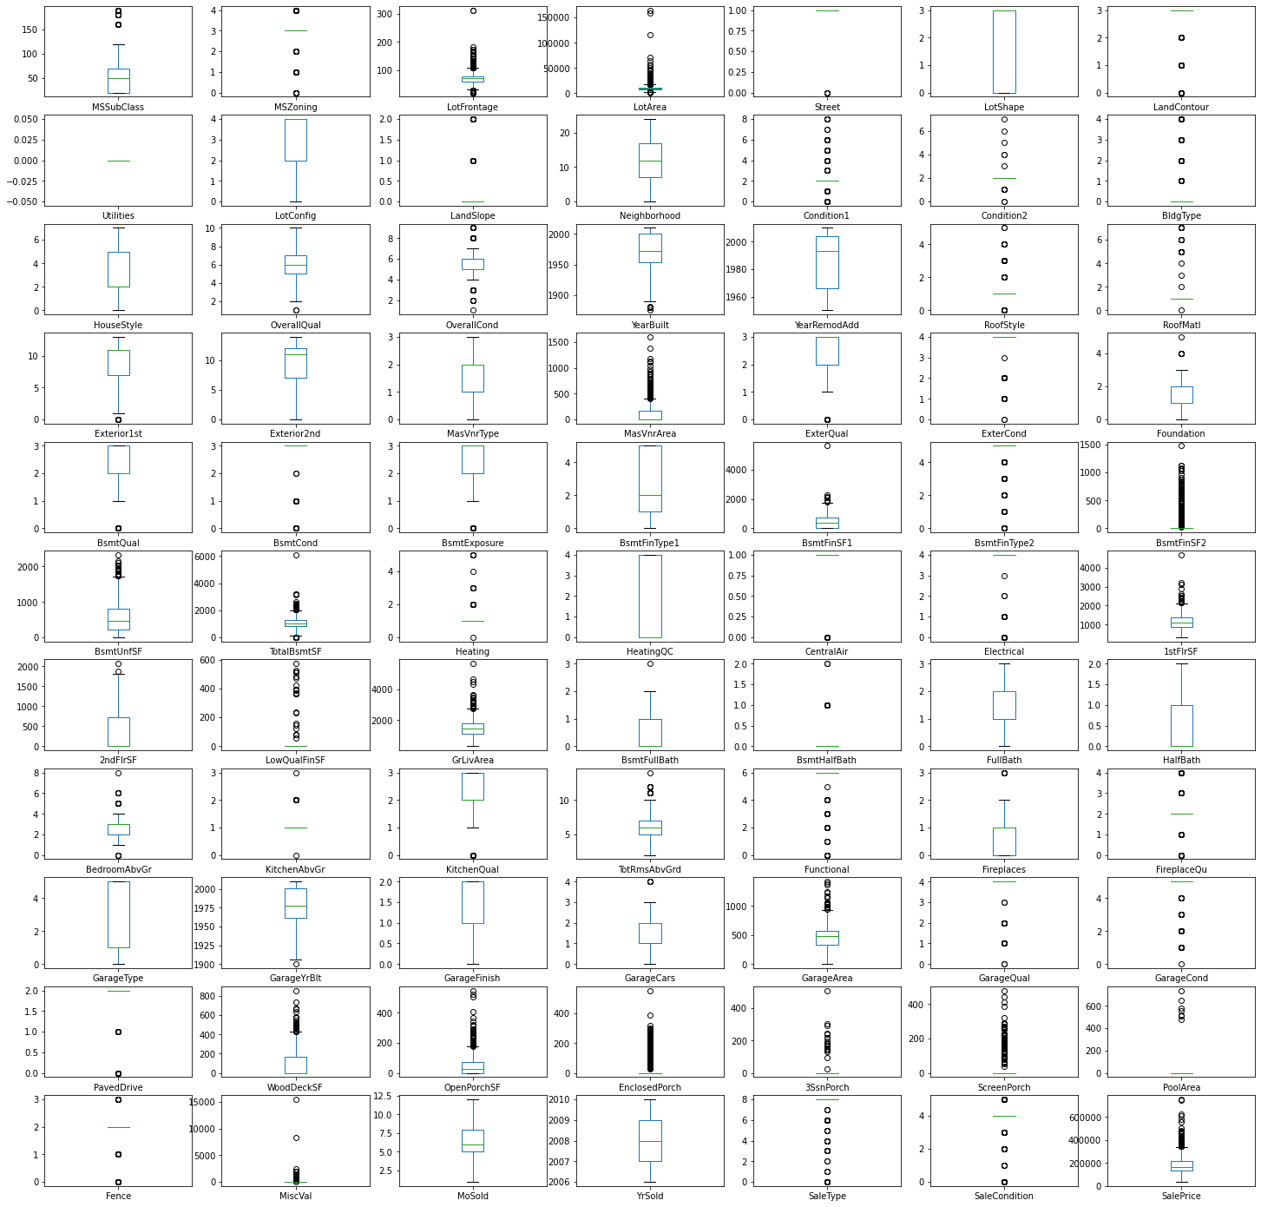
ength: 77, dtype: object

Slide 14
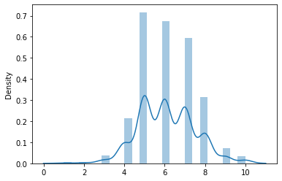
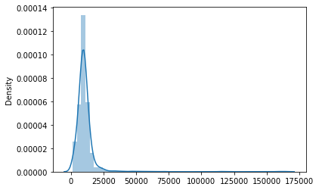
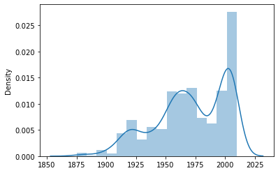
Checking distribution
YearBuilt

Slide 15
Scaling data
from sklearn.preprocessing import MinMaxScaler
scaler=MinMaxScaler()
from sklearn.ensemble import GradientBoostingRegressor
from sklearn.metrics import mean_squared_error,r2_score
from sklearn.model_selection import cross_val_score
gbr = GradientBoostingRegressor(random_state=0)
model=gbr.fit(x_train,y_train)
score=cross_val_score(model,x_train,y_train,cv=5,scoring="r2")
print("cv_score=",score)
cv_score= [0.90380086 0.76521917 0.90290431 0.90436564 0.8649859 ]

Slide 16
Conclusion
Model used are
Randomforestregressor
KNeighborsRegressor
LinearRegression
GradientBoostingRegressor.
AdaBoostRegressor
As gradientboostingregressor giving more accuracy so we will consider it as best model

